Slide 1
Modeling Physics
Sayan Mitra
Verifying cyberphysical systems
mitras@illinois.edu

Slide 2
Plan
Dynamical system models
notions of solutions
Linear dynamical systems
Connection to automata
Stability
Lyapunov method

Slide 3
Map of CPS models
Dynamical systems
Differential inclusions
Discrete transition systems, automata
Markov chains
Probabilistic automata, Markov decision processes (MDP)
Continuous time, continuous state MDPs
Hybrid systems
Stochastic Hybrid systems

Slide 4
All this was in the two plague years 1665 and 1666, for in those days I was in my prime of age for invention, and minded mathematics and philosophy more than at any time since.
---Isaac Newton
From: Wilczek, Frank. A Beautiful Question: Finding Nature's Deep Design (p. 87).
Notes:
In the years 1665–66 bubonic plague broke out in England. Cambridge University shut down, sending the 22 year-old undergraduate [Issac Newton] back to his family farm at Woolsthorpe. During that time Newton had breakthrough insights in mathematics (infinite series and calculus), mechanics (idea of universal gravity), and optics (theory of colors). As he describes it:

Slide 5
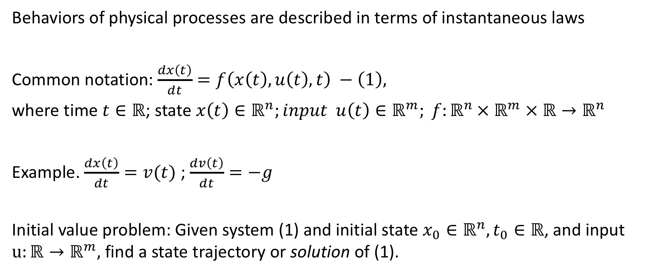
Introduction to dynamical systems
Behaviors of physical processes are described in terms of instantaneous laws
Common notation: $\frac{dx\left(t\right)}{dt}=f\left(x\left(t\right),u\left(t\right),t\right) −\left(1\right),$
where time $t∈ℝ$; state $x\left(t\right)∈ℝ^{n};input u\left(t\right)∈ℝ^{m}; f:ℝ^{n }×{ ℝ}^{m} × ℝ→ℝ^{n}$
Example. $\frac{dx\left(t\right)}{dt}=v(t)$ ; $\frac{dv\left(t\right)}{dt}=−g$
Initial value problem: Given system (1) and initial state $x_{0}∈ℝ^{n}, t_{0}∈ℝ$, and input $u:ℝ→ℝ^{m},$ find a state trajectory or solution of (1).

Slide 6
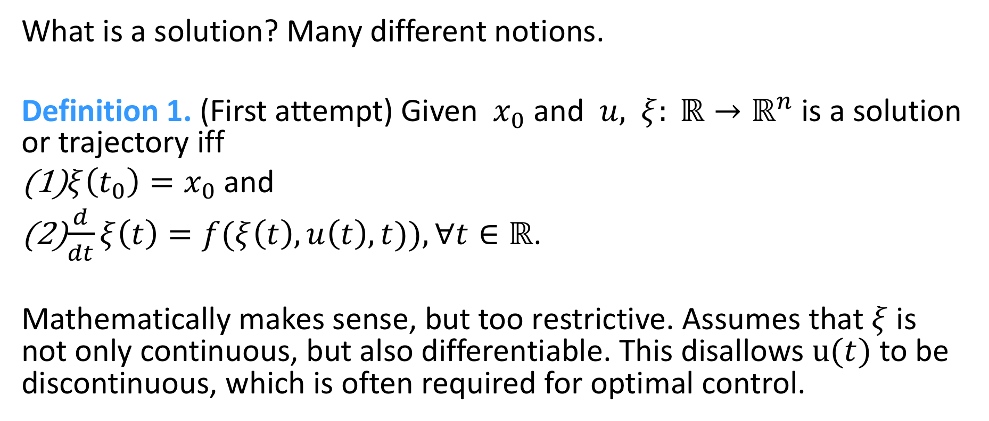
Notions of solution
What is a solution? Many different notions.
Definition 1. (First attempt) Given $x_{0}$ and $u,$ $ξ: ℝ→ℝ^{n}$ is a solution or trajectory iff
$ξ\left(t_{0}\right)=x_{0}$ and
$\frac{d}{dt}ξ\left(t\right)=f(ξ\left(t\right),u\left(t\right),t)), ∀t∈ℝ$.
Mathematically makes sense, but too restrictive. Assumes that $ξ$ is not only continuous, but also differentiable. This disallows $u(t)$ to be discontinuous, which is often required for optimal control.

Slide 7
Getting from point a to point b

Slide 8
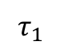
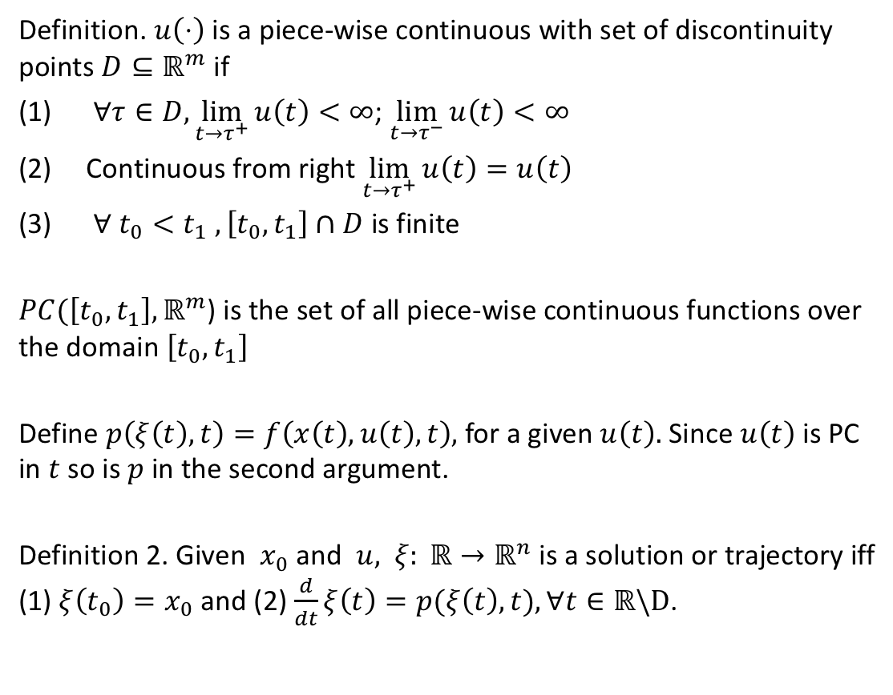
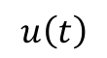
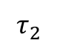
Modified notion
Definition. $u\left(⋅\right)$ is a piece-wise continuous with set of discontinuity points $D⊆ℝ^{m}$ if
$∀τ∈D,\lim_{t→τ^{+}}{u\left(t\right)}<∞$; $\lim_{t→τ^{−}}{u\left(t\right)<∞}$
Continuous from right$\lim_{t→τ^{+}}{u\left(t\right)}=u\left(t\right)$
$∀ t_{0}<t_{1}$ $,\left[t_{0},t_{1}\right]∩D$ is finite
$PC(\left[t_{0},t_{1}\right],ℝ^{m}$) is the set of all piece-wise continuous functions over the domain $\left[t_{0},t_{1}\right]$
Define $p\left(ξ\left(t\right),t\right)=f\left(x\left(t\right),u\left(t\right),t\right),$ for a given $u\left(t\right).$ Since $u\left(t\right)$ is PC in $t$ so is $p$ in the second argument.
Definition 2. Given $x_{0}$ and $u,$ $ξ: ℝ→ℝ^{n}$ is a solution or trajectory iff (1) $ξ\left(t_{0}\right)=x_{0}$ and (2) $\frac{d}{dt}ξ\left(t\right)=p(ξ\left(t\right),t), ∀t∈ℝ\backslash D$.
$$u\left(t\right)$$
$$τ_{1}$$
$$τ_{2}$$

Slide 9
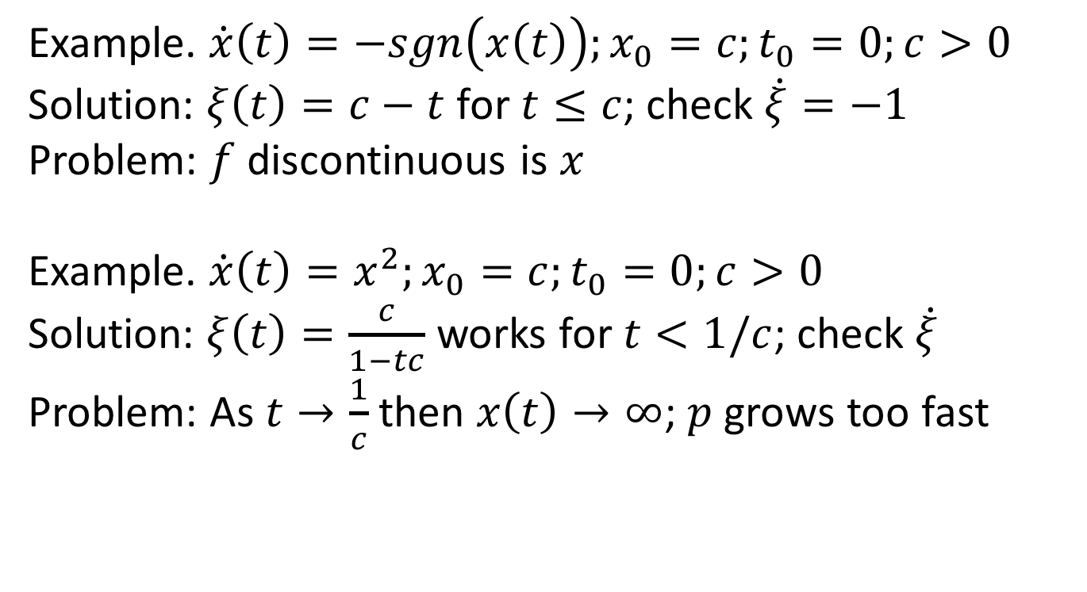

Is PC input $u\left(t\right)$ adequate for guaranteeing existence of solutions?
Example. $\dot{x}\left(t\right)=−sgn\left(x\left(t\right)\right);x_{0}=c;t_{0}=0;c>0$
Solution: $ξ\left(t\right)=c−t$ for $t≤c$; check $\dot{ξ}=−1$
Problem: $f$ discontinuous is $x$
Example. $\dot{x}\left(t\right)=x^{2};x_{0}=c;t_{0}=0;c>0$
Solution: $ξ\left(t\right)=\frac{c}{1−tc}$ works for $t<1/c$; check $\dot{ξ}$
Problem: As $t→\frac{1}{c}$ then $x\left(t\right)→∞$; $p$ grows too fast

Slide 10
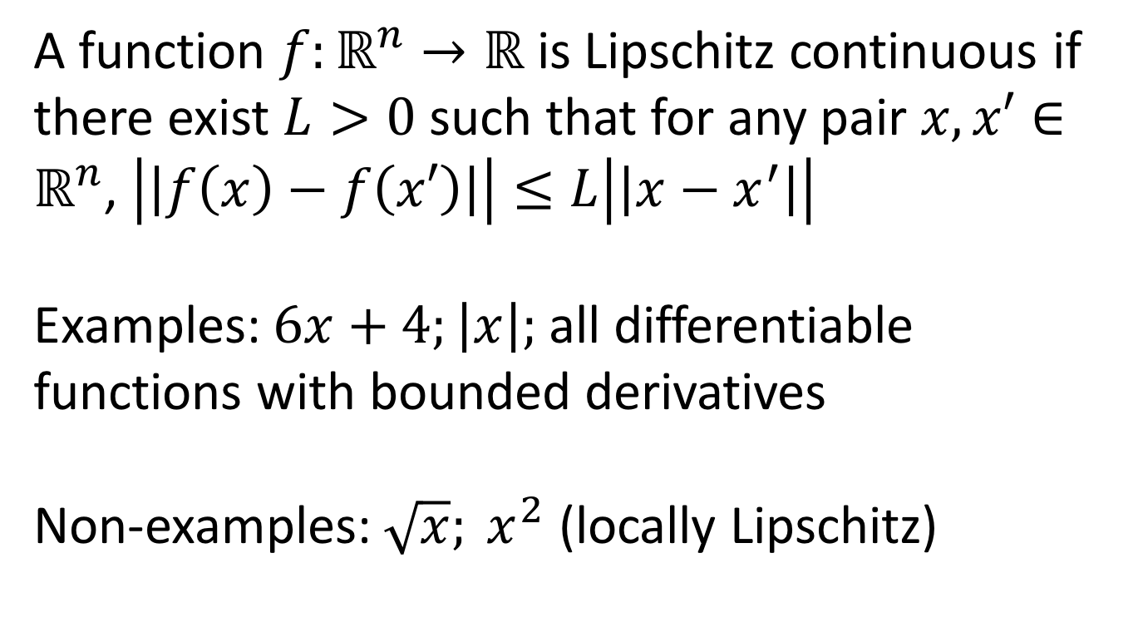
Lipschitz continuity
A function $f:ℝ^{n}→ℝ$ is Lipschitz continuous if there exist $L>0$ such that for any pair $x,x′∈ℝ^{n}$, $\left|\left|f\left(x\right)−f\left(x′\right)\right|\right|≤L\left|\left|x−x^{′}\right|\right|$
Examples: $6x+4;\left|x\right|;$ all differentiable functions with bounded derivatives
Non-examples: $\sqrt{x}; x^{2}$ (locally Lipschitz)

Slide 11
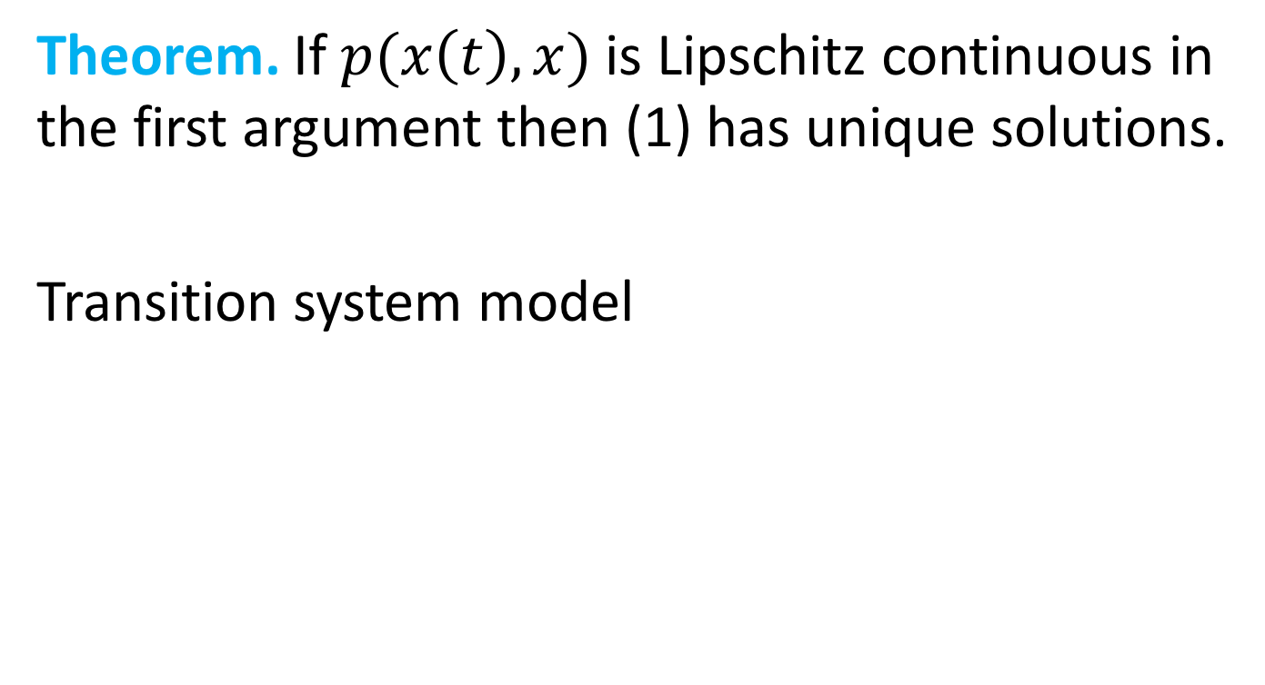
Existence and uniqueness of solutions
Theorem. If $p(x\left(t\right),x)$ is Lipschitz continuous in the first argument then (1) has unique solutions.
Transition system model

Slide 12
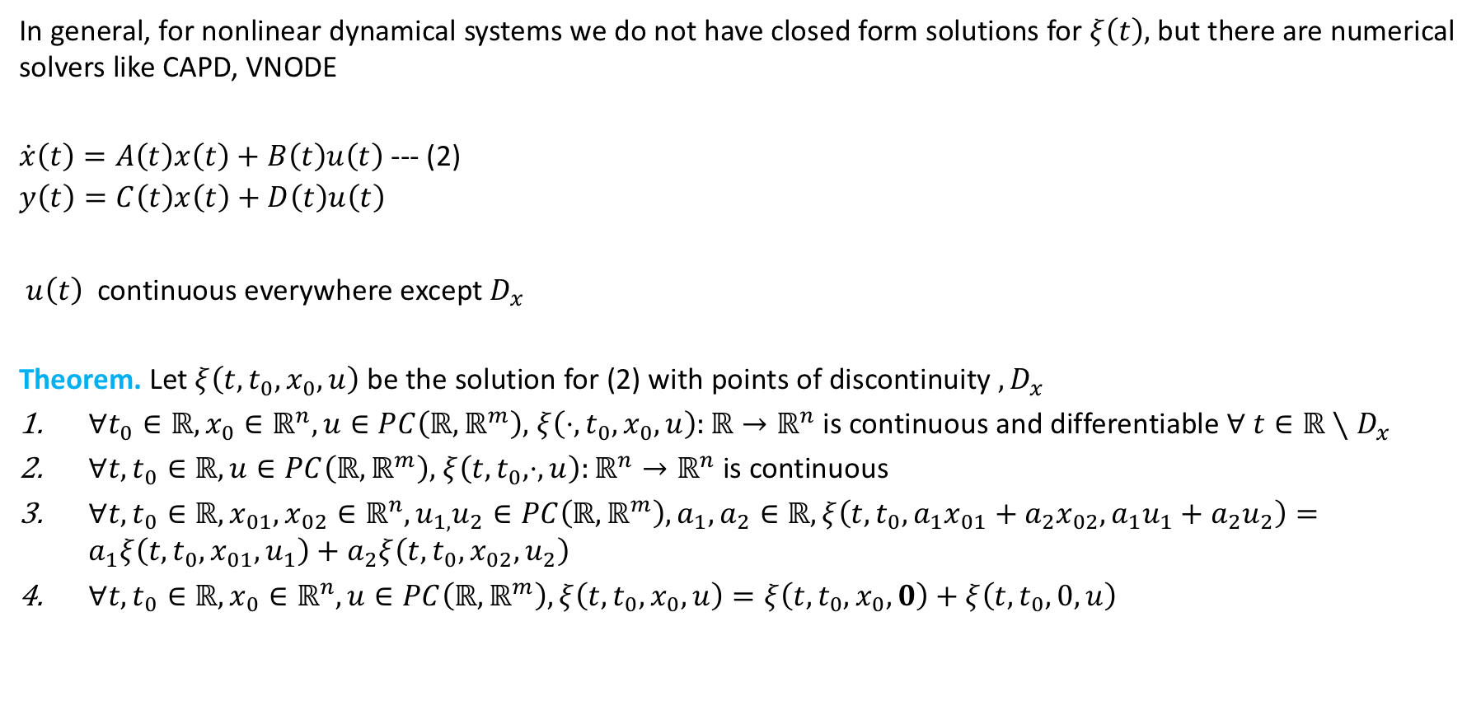
Linear time-varying systems
In general, for nonlinear dynamical systems we do not have closed form solutions for $ξ\left(t\right),$ but there are numerical solvers like CAPD, VNODE
$\dot{x}\left(t\right)=A\left(t\right)x\left(t\right)+B\left(t\right)u\left(t\right)$ --- (2)
$$y\left(t\right)=C\left(t\right)x\left(t\right)+D\left(t\right)u\left(t\right)$$
$u\left(t\right)$ continuous everywhere except $D_{x}$
Theorem. Let $ξ\left(t,t_{0},x_{0},u\right)$ be the solution for (2) with points of discontinuity $,D_{x}$
$∀t_{0}∈ℝ,x_{0}∈ℝ^{n},u∈PC\left(ℝ,ℝ^{m}\right),$ $ξ\left(⋅,t_{0},x_{0},u\right):ℝ→ℝ^{n}$ is continuous and differentiable $∀ t∈ℝ∖D_{x}$
$∀t,t_{0}∈ℝ, u∈PC\left(ℝ,ℝ^{m}\right),$ $ξ\left(t,t_{0},⋅,u\right):ℝ^{n}→ℝ^{n}$ is continuous
$∀{t,t}_{0}∈ℝ,x_{01},x_{02}∈ℝ^{n},u_{1,}u_{2}∈PC\left(ℝ,ℝ^{m}\right),a_{1},a_{2}∈ℝ, ξ\left(t,t_{0},a_{1}x_{01}+a_{2}x_{02},a_{1}u_{1}+a_{2}u_{2}\right)=a_{1}ξ\left(t,t_{0}, x_{01}, u_{1}\right)+a_{2}ξ\left(t,t_{0}, x_{02}, u_{2}\right)$
$∀{t,t}_{0}∈ℝ, x_{0}∈ℝ^{n},u∈PC\left(ℝ,ℝ^{m}\right), ξ\left(t,t_{0}, x_{0}, u\right)=ξ\left(t,t_{0}, x_{0}, 0\right)+ξ\left(t,t_{0}, 0, u\right)$

Slide 13
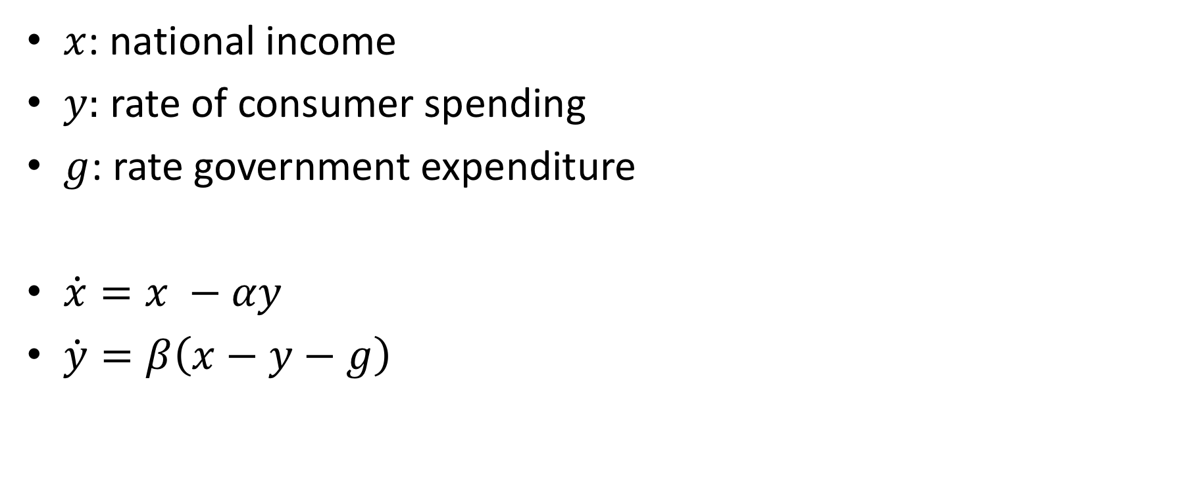
Example 1: Simple model of an economy
$x$: national income
$y:$ rate of consumer spending
$g$: rate government expenditure
$\dot{x}=x −αy$
$\dot{y}=β\left(x−y−g\right)$

Slide 14
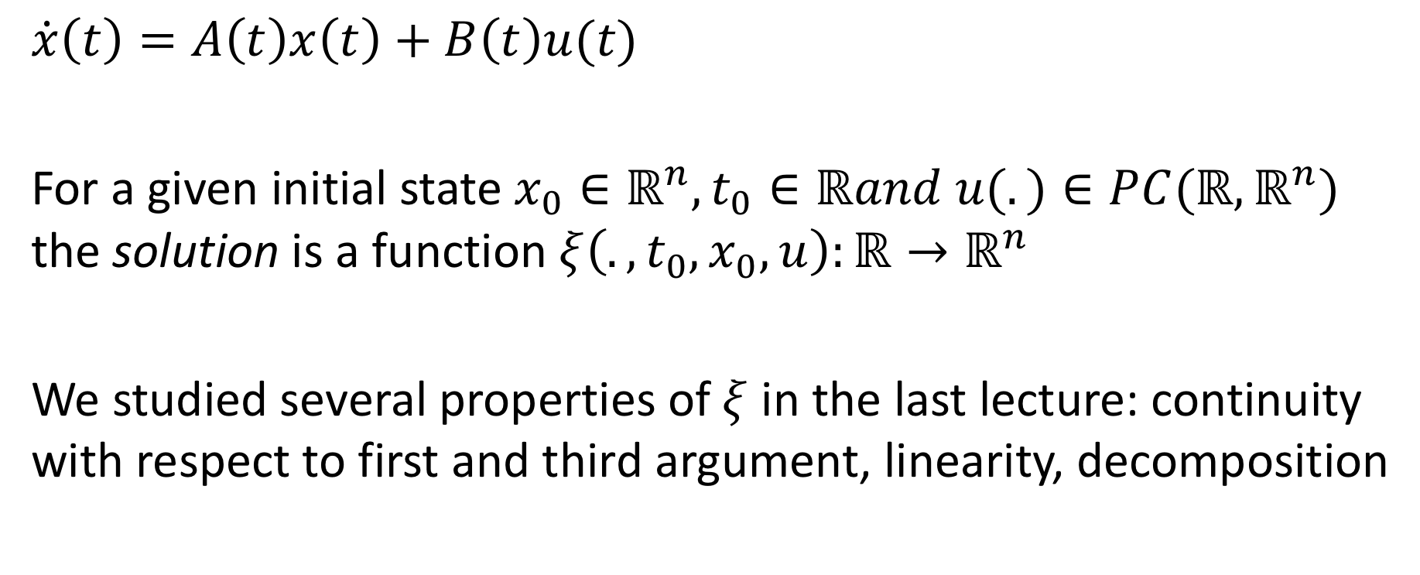
Linear system and solutions
$$\dot{x}\left(t\right)=A\left(t\right)x\left(t\right)+B\left(t\right)u(t)$$
For a given initial state $x_{0}∈ℝ^{n},t_{0}∈ℝand u(.)∈PC(ℝ,ℝ^{n})$ the solution is a function $ξ\left(.,t_{0},x_{0},u\right):{ℝ→ℝ}^{n}$
We studied several properties of $ξ$ in the last lecture: continuity with respect to first and third argument, linearity, decomposition

Slide 15
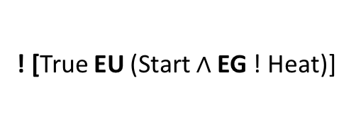
Linear system and solutions
Since $ξ\left(.,t_{0},x_{0},u\right):{ℝ→ℝ}^{n}$ is a linear function of the initial state and input,
$ξ\left(t,t_{0},x_{0},u\right)$ = $ξ\left(t,t_{0},0,u\right)$ + $ξ\left(.,t_{0},x_{0},0\right)$
Let us focus on the linear function $ξ\left(.,t_{0},x_{0},0\right)$
Define $Φ\left(.,t_{0}\right)x_{0}=ξ\left(.,t_{0},x_{0},u\right)$
This $Φ\left(.,t_{0}\right)$:${ℝ→ℝ}^{n×n}$ is called the state transition matrix

Slide 16
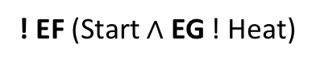
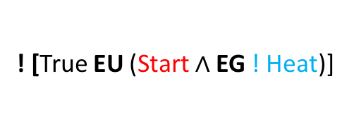
Properties of $Φ$
$Φ\left(.,t_{0}\right):{ℝ→ℝ}^{n×n}$ is the unique solution of (2) and is defined by a (Peano-Baker) infinite sequence of integrals
$\frac{∂}{∂t}Φ\left(t,t_{0}\right)=A\left(t\right)Φ(t,t_{0})$ with $Φ\left(t,t\right)=I$
Continuous everywhere
Differentiable everywhere except $D_{x}$ ($A\left(t\right)$ isn’t)
$∀t_{0},t_{1},t$ $Φ\left(t,t_{0}\right)=Φ\left(t,t_{1}\right)Φ\left(t_{1},t_{0}\right)$
$Φ\left(t,t_{0}\right)$ is invertible ${\left[Φ\left(t,t_{0}\right)\right]}^{−1}=Φ\left(t_{0},t\right)$

Slide 17


Solution of linear systems in $Φ$
Theorem.
$$ξ\left(t,t_{0},x_{0},u\right)=Φ\left(t,t_{0}\right)x_{0}+\int_{t_{0}}^{t}{Φ\left(t,τ\right)B\left(τ\right)u\left(τ\right)dτ}$$

Slide 18
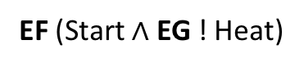
Linear time invariant system
$$\dot{x}\left(t\right)=Ax\left(t\right)+Bu\left(t\right)$$
Matrix exponential:
$$e^{At}=1+At+\frac{1}{2!}{\left(At\right)}^{2}+ …=\sum_{0}^{∞}{\frac{1}{k!}{\left(At\right)}^{k}}$$
Theorem. $Φ\left(t,t_{0}\right)=e^{A\left(t−t_{0}\right)}$, that is
$$ξ\left(t,t_{0},x_{0},u\right)={x_{0}e}^{A(t−t_{0})}+\int_{t_{0}}^{t}{e^{A(t−τ)}Bu\left(τ\right)dτ}$$

Slide 19
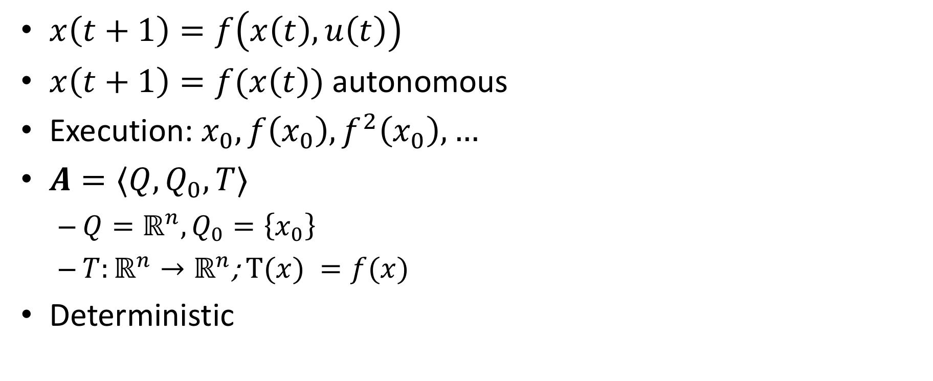
Discrete time models / discrete transition systems
$x\left(t+1\right)=f\left(x\left(t\right), u\left(t\right)\right)$
$x\left(t+1\right)=f(x\left(t\right))$ autonomous
Execution: $x_{0},f\left(x_{0}\right), f^{2}\left(x_{0}\right),…$
$A=⟨Q,Q_{0},T⟩$
$Q=ℝ^{n}, Q_{0}=\left\{x_{0}\right\}$
${T:ℝ}^{n}→ℝ^{n}$; $T(x) =f(x)$
Deterministic

Slide 20
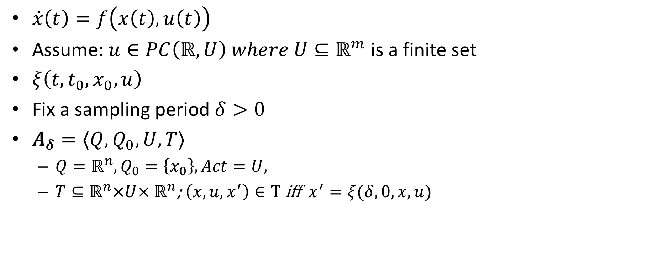
Discretized or sampled-time model
$\dot{x}\left(t\right)=f\left(x\left(t\right), u\left(t\right)\right)$
Assume: $u∈PC\left(ℝ,U\right) where U⊆ℝ^{m}$ is a finite set
$ξ\left(t,t_{0},x_{0},u\right)$
Fix a sampling period $δ>0$
$A_{δ}=⟨Q,Q_{0},U,T⟩$
$Q=ℝ^{n}, Q_{0}=\left\{x_{0}\right\}, Act=U,$
${T⊆ℝ}^{n}×U× ℝ^{n}$; $\left(x,u,x^{′}\right)∈T$iff $x^{′}=ξ(δ, 0,x,u)$

Slide 21
Properties for dynamical systems
What type of properties are we interested in?
Invariance (as in the case of automata)
State remains bounded
Converges to target
Bounded input gives bounded output (BIBO)

Slide 22
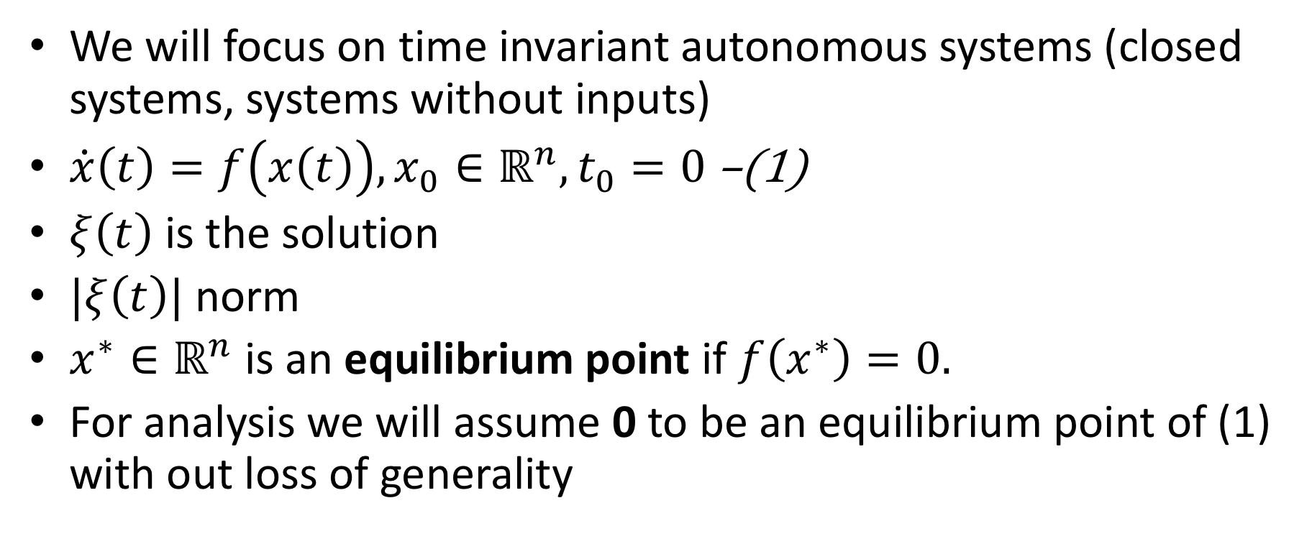
Requirements: Stability
We will focus on time invariant autonomous systems (closed systems, systems without inputs)
$\dot{x}\left(t\right)=f\left(x\left(t\right)\right), x_{0}∈ℝ^{n}, t_{0}=0$ –(1)
$ξ\left(t\right)$ is the solution
$|ξ\left(t\right)|$ norm
$x^{∗}∈ℝ^{n}$ is an equilibrium point if $f\left(x^{∗}\right)=0.$
For analysis we will assume 0 to be an equilibrium point of (1) with out loss of generality

Slide 23
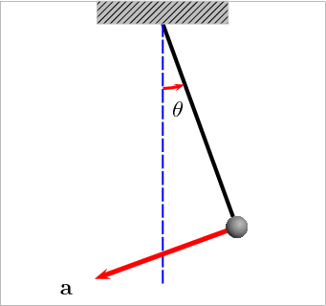
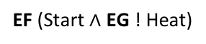
Example: Pendulum
Pendulum equation
$$x_{1}=θ x_{2}=\dot{θ}$$
$$x_{2}={\dot{x}}_{1}$$
$${\dot{x}}_{2}=−\frac{g}{l}\sin\left(x_{1}\right)−\frac{k}{m}x_{2}$$
$\left[\begin{matrix}\dot{x_{2}} \\ \dot{x_{1}}\end{matrix}\right]$= $\left[\begin{matrix}−\frac{g}{l}\sin\left(x_{1}\right)−\frac{k}{m}x_{2} \\ x_{2}\end{matrix}\right]$
$k:$ friction coefficient
Two equilibrium points: $\left(0,0\right), (π,0)$
upright
down

Slide 24
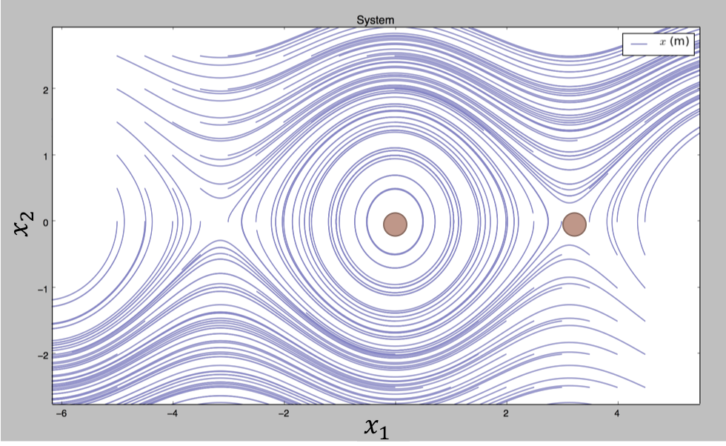
CW
stable
speed=0
unstable
upright
down
CCW
Notes:
left to right angle of the pendulum: line : hanging right at the bottom
up : higher speed CW, down higher speed CCW, on this line speed 0
Now as its hanging at the bottom I give the pen a slight tap.. give it some speed… and plot all the angles and the corresponding speeds… what would this look like?

Slide 25
Aleksandr M. Lyapunov
Aleksandr Mikhailovich Lyapunov (June 6 1857–November 3, 1918) was a Russian mathematician and physicist.
His methods make it possible to define the stability of ordinary differential equations. In the theory of probability, he generalized the works of Chebyshev and Markov, and proved the Central Limit Theorem under more general conditions than his predecessors.

Slide 26
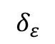
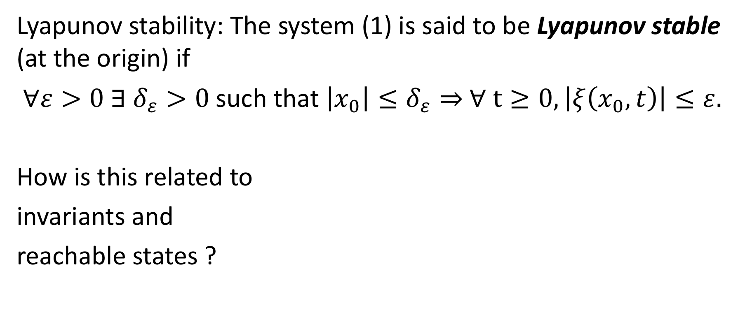
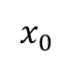
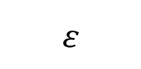
Lyapunov stability
Lyapunov stability: The system (1) is said to be Lyapunov stable (at the origin) if
$∀ε>0 ∃$ $δ_{ε}>0$such that $\left|x_{0}\right|≤δ_{ε}⇒$ $∀ t≥0, \left|ξ\left(x_{0},t\right)\right|≤ε.$
How is this related to
invariants and
reachable states ?
$$δ_{ε}$$
$$x_{0}$$
$$ε$$

Slide 27
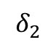
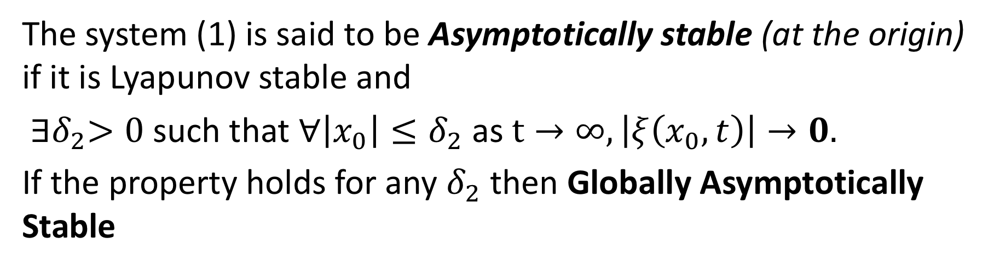
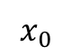
Asymptotically stability
The system (1) is said to be Asymptotically stable (at the origin) if it is Lyapunov stable and
${∃δ}_{2}>0$such that $∀\left|x_{0}\right|≤δ_{2}$ as $t→∞, \left|ξ\left(x_{0},t\right)\right|→0.$
If the property holds for any $δ_{2}$ then Globally Asymptotically Stable
$$δ_{2}$$
$$x_{0}$$

Slide 28
Phase portrait of pendulum with friction

Slide 29
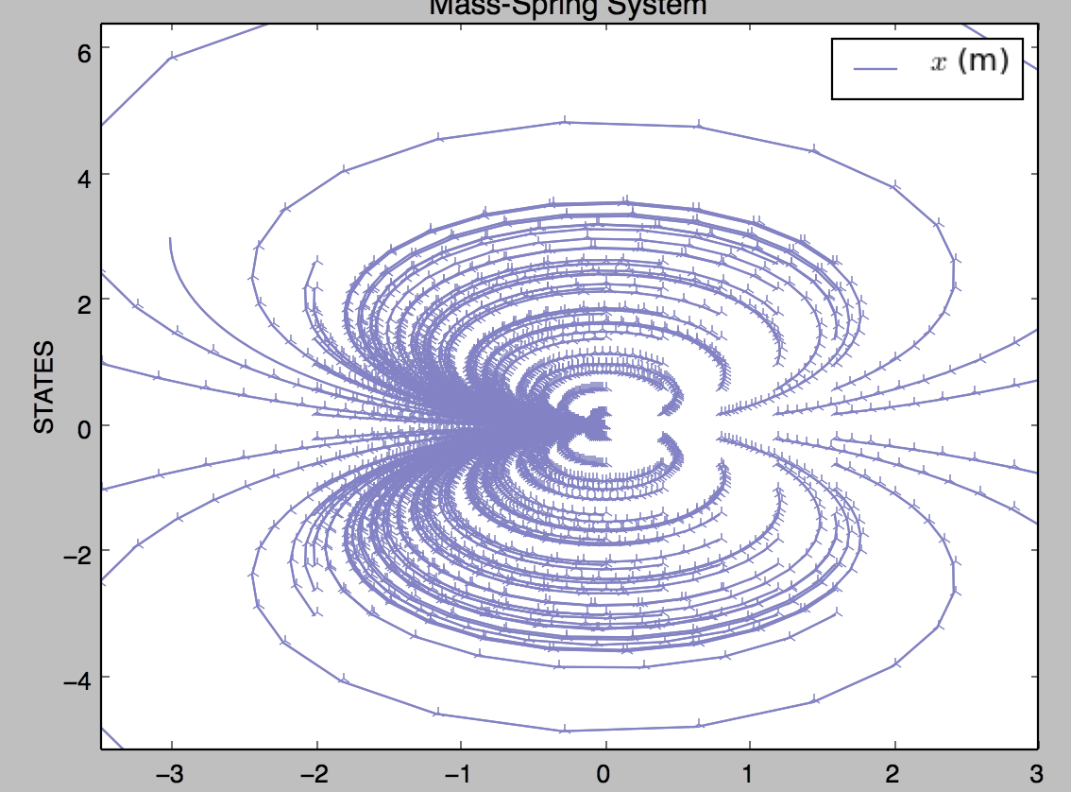
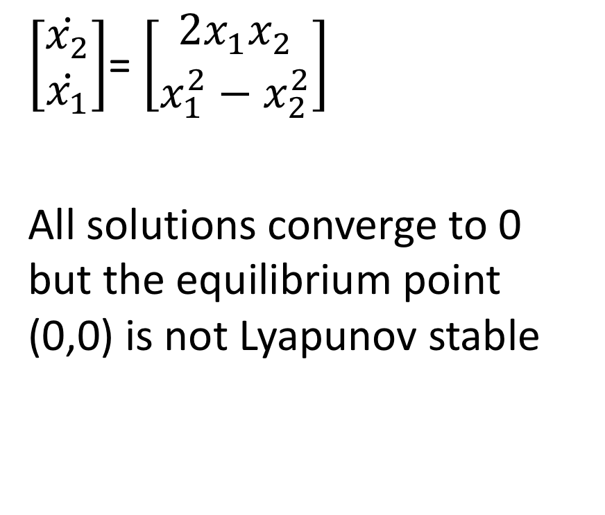
Butterfly*
$\left[\begin{matrix}\dot{x_{2}} \\ \dot{x_{1}}\end{matrix}\right]$= $\left[\begin{matrix}2x_{1}x_{2} \\ x_{1}^{2}−x_{2}^{2}\end{matrix}\right]$
All solutions converge to 0 but the equilibrium point (0,0) is not Lyapunov stable
*Not discussed in class

Slide 30
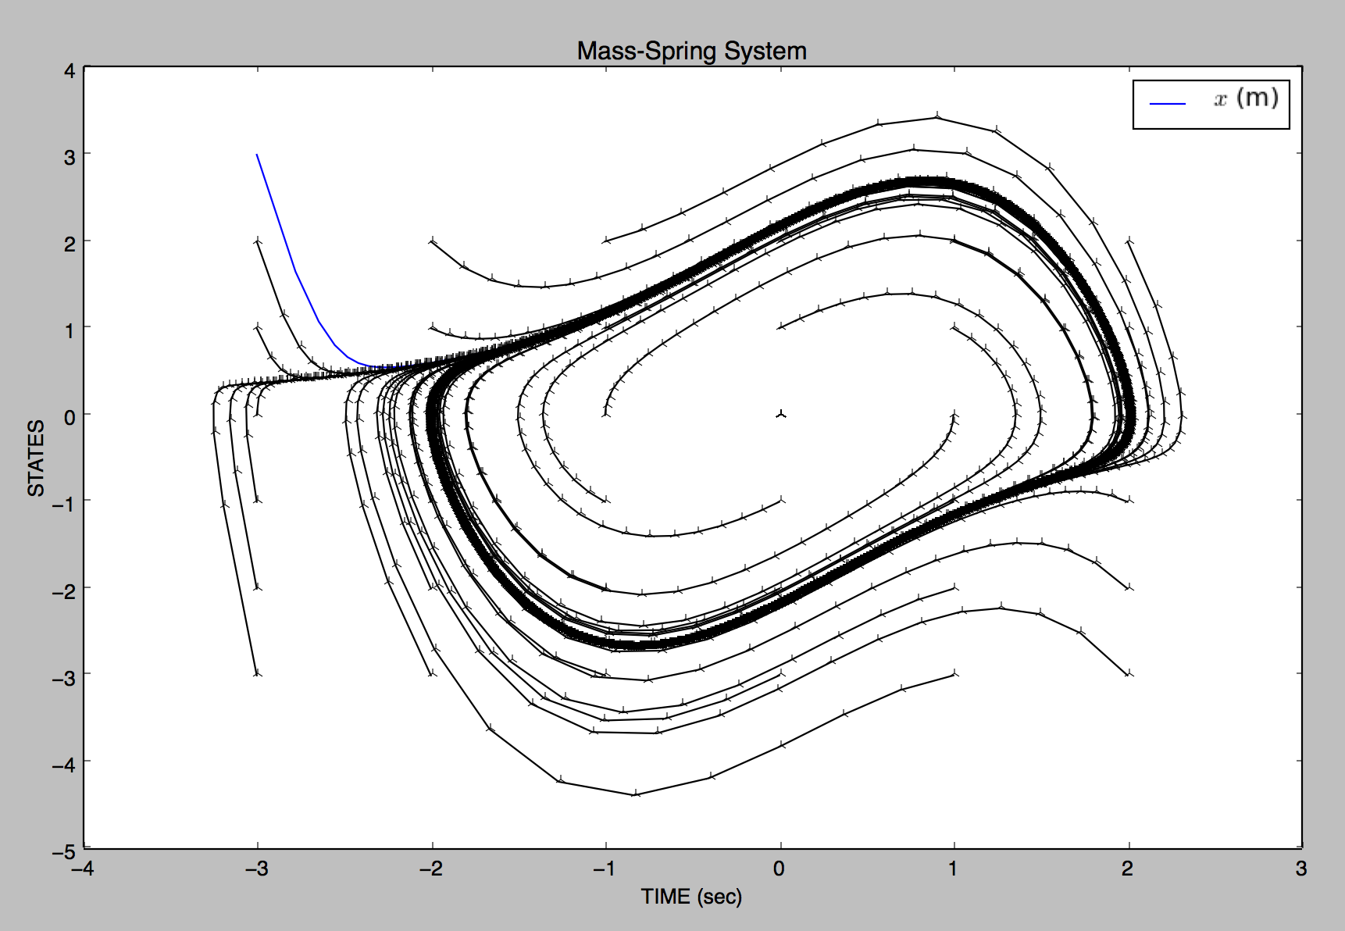
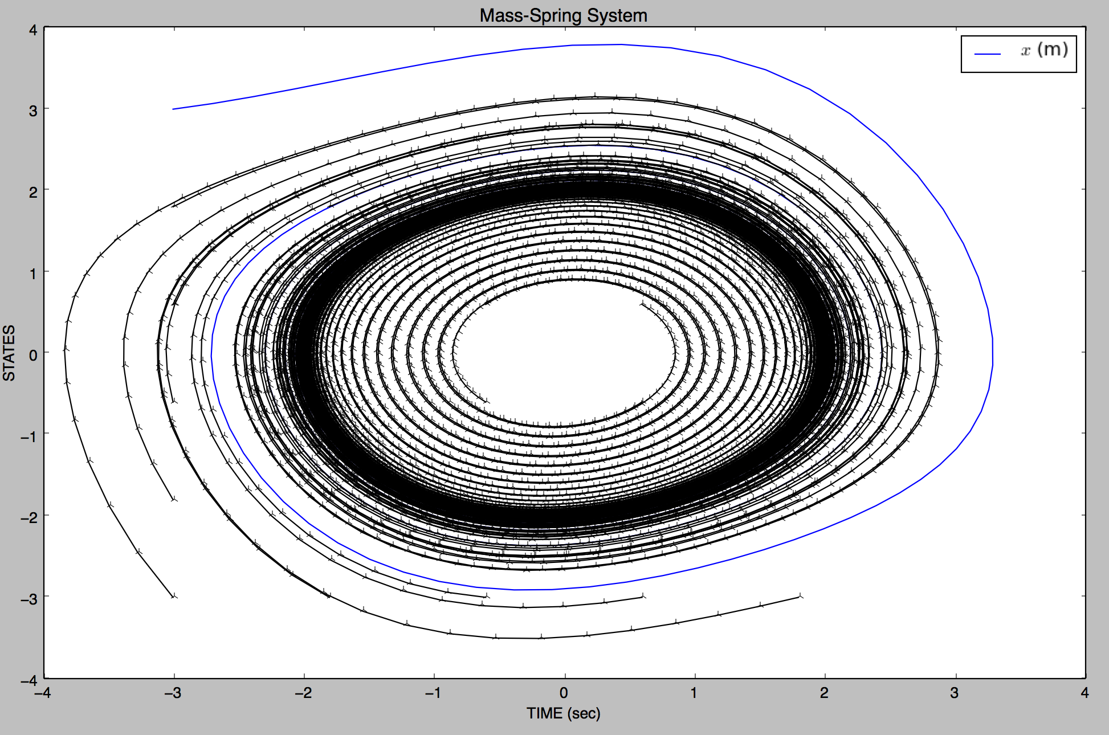
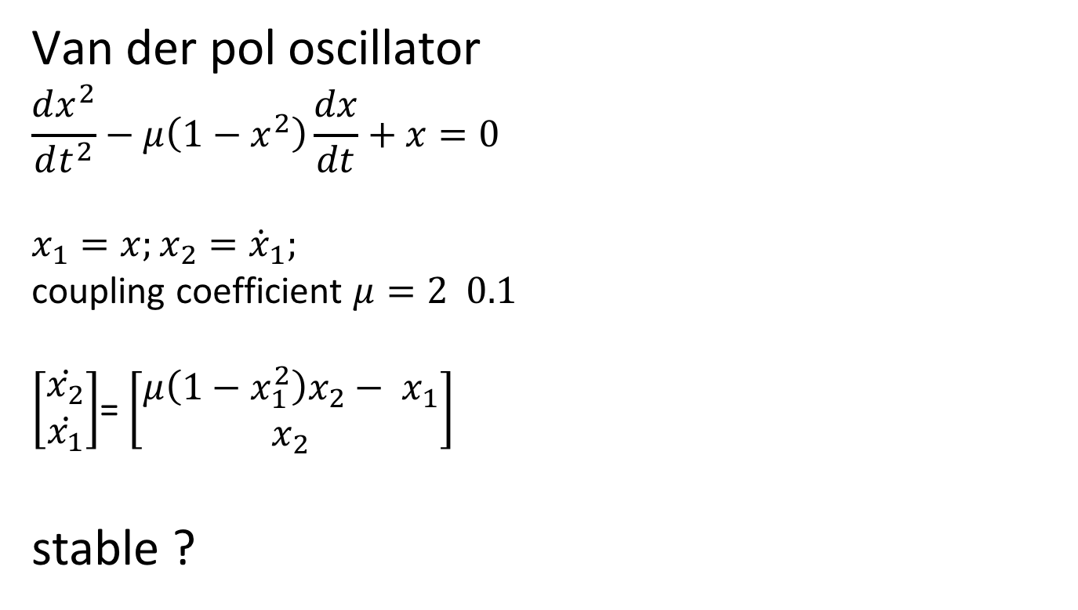
Van der pol oscillator
Van der pol oscillator
$$\frac{dx^{2}}{dt^{2}}−μ\left(1−x^{2}\right)\frac{dx}{dt}+x=0$$
$$x_{1}=x;x_{2}={\dot{x}}_{1};$$
coupling coefficient $μ=2 0.1$
$\left[\begin{matrix}\dot{x_{2}} \\ \dot{x_{1}}\end{matrix}\right]$= $\left[\begin{matrix}μ\left(1−x_{1}^{2}\right)x_{2}− x_{1} \\ x_{2}\end{matrix}\right]$
stable ?

Slide 31
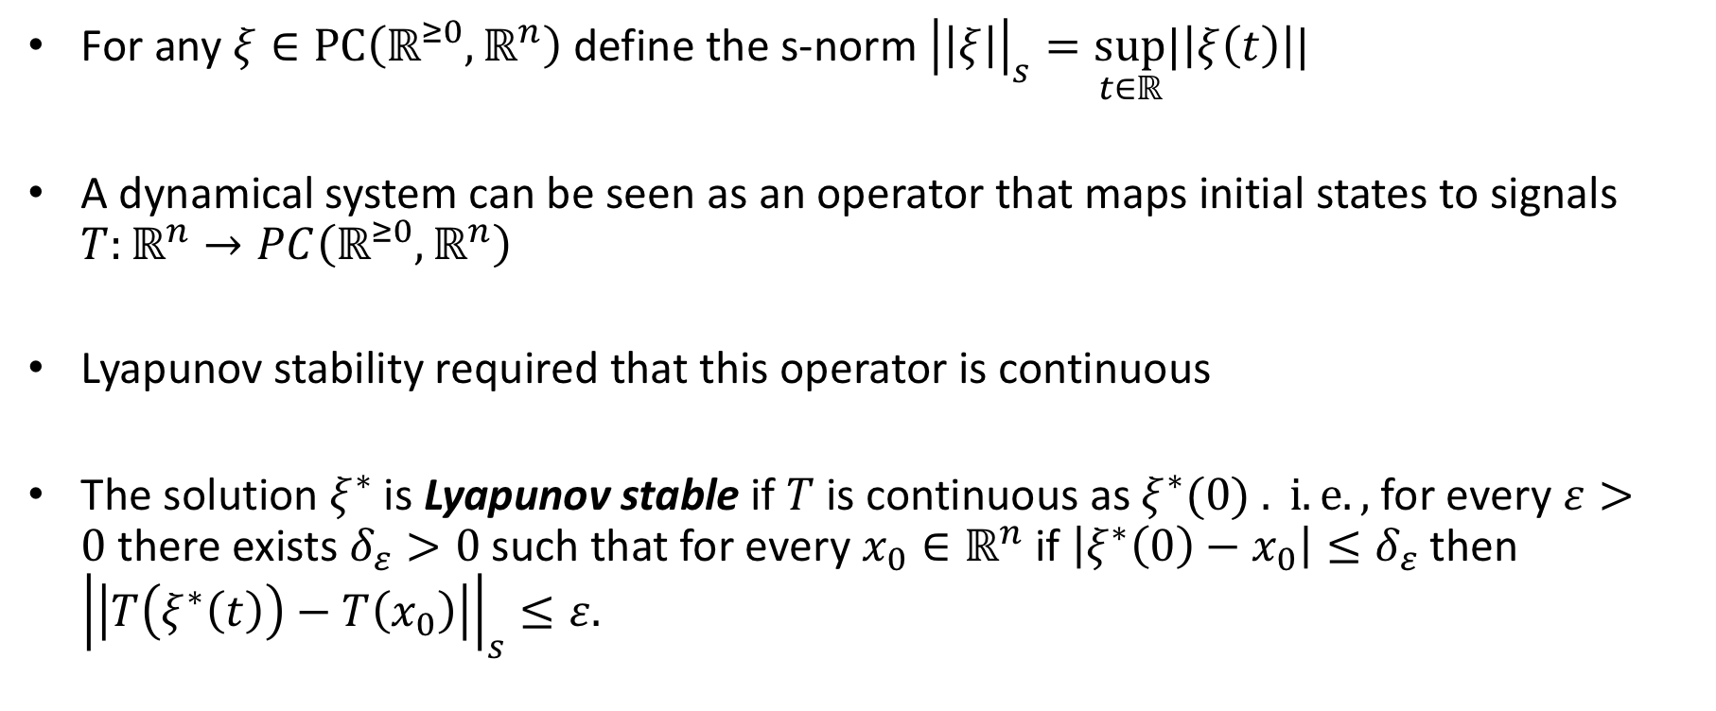
Stability of solutions* (instead of points)
For any $ξ∈PC\left(ℝ^{≥0},ℝ^{n}\right)$ define the s-norm ${\left|\left|ξ\right|\right|}_{s}=\sup_{t∈ℝ}|\left|ξ\left(t\right)\right||$
A dynamical system can be seen as an operator that maps initial states to signals $T:ℝ^{n}→PC\left(ℝ^{≥0},ℝ^{n}\right)$
Lyapunov stability required that this operator is continuous
The solution $ξ^{∗}$ is Lyapunov stable if $T$ is continuous as $ξ^{∗}(0) . i.e.,$for every $ε>0$there exists $δ_{ε}>0$such that for every $x_{0}∈ℝ^{n}$ if $\left|ξ^{∗}\left(0\right)−x_{0}\right|≤δ_{ε}$ then ${\left|\left|T\left(ξ^{∗}\left(t\right)\right)−T\left(x_{0}\right)\right|\right|}_{s}≤ε.$
*Not discussed in class

Slide 32
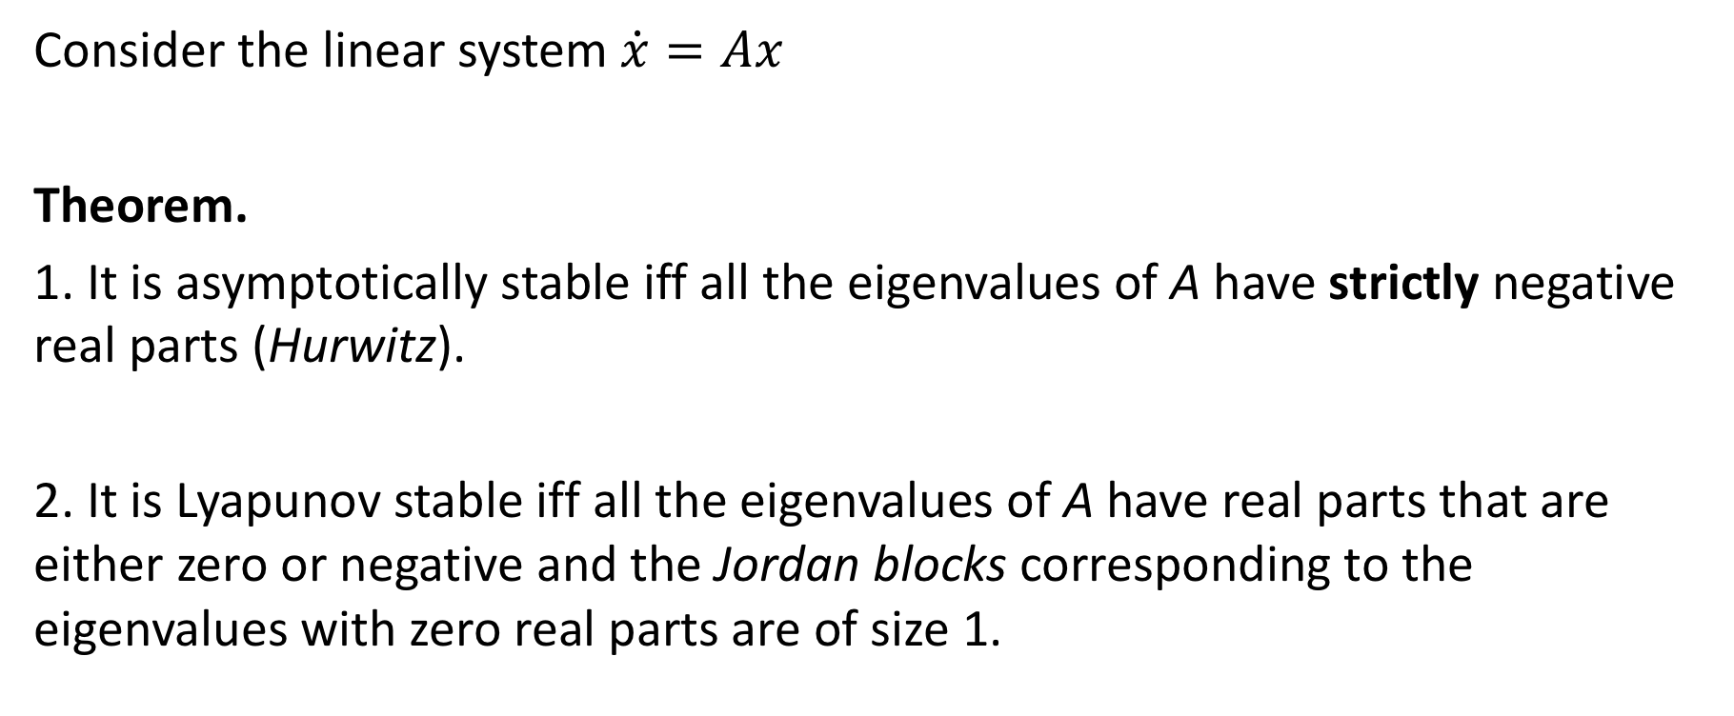
Verifying Stability for Linear Systems
Consider the linear system $\dot{x}=Ax$
Theorem.
1. It is asymptotically stable iff all the eigenvalues of A have strictly negative real parts (Hurwitz).
2. It is Lyapunov stable iff all the eigenvalues of A have real parts that are either zero or negative and the Jordan blocks corresponding to the eigenvalues with zero real parts are of size 1.

Slide 33
Jordan decomposition
For every n x n matrix A, there exists a nonsingular n x n matrix P such that
where each $J_{i}$ is a upper triangular matrix called a Jordan block

Slide 34
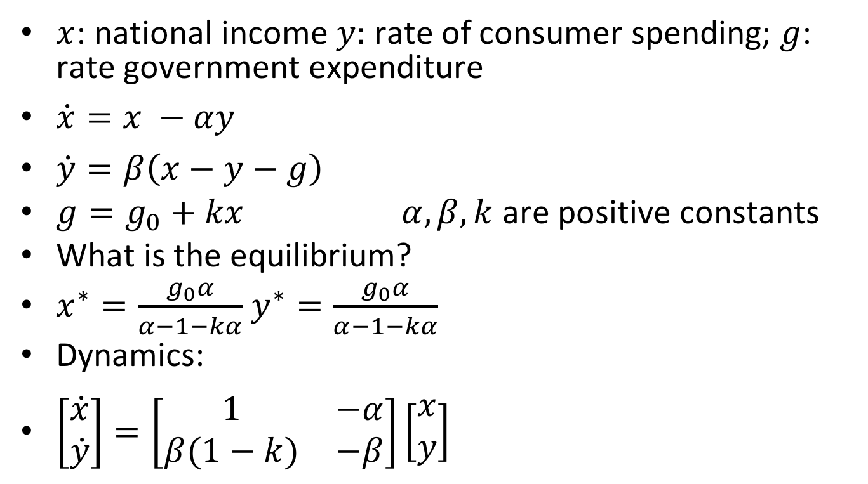
Example 1: Simple model of an economy
$x$: national income $y:$ rate of consumer spending; $g$: rate government expenditure
$\dot{x}=x −αy$
$\dot{y}=β\left(x−y−g\right)$
$g=g_{0}+kx$ $α, β, k$ are positive constants
What is the equilibrium?
$x^{∗}=\frac{g_{0}α}{α−1−kα}$ $y^{∗}=\frac{g_{0}α}{α−1−kα}$
Dynamics:
$\left[\begin{matrix}\dot{x} \\ \dot{y}\end{matrix}\right]=\left[\begin{matrix}1 & −α \\ β(1−k) & −β\end{matrix}\right]\left[\begin{matrix}x \\ y\end{matrix}\right]$

Slide 35
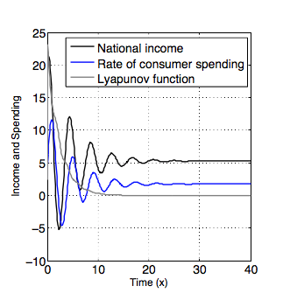
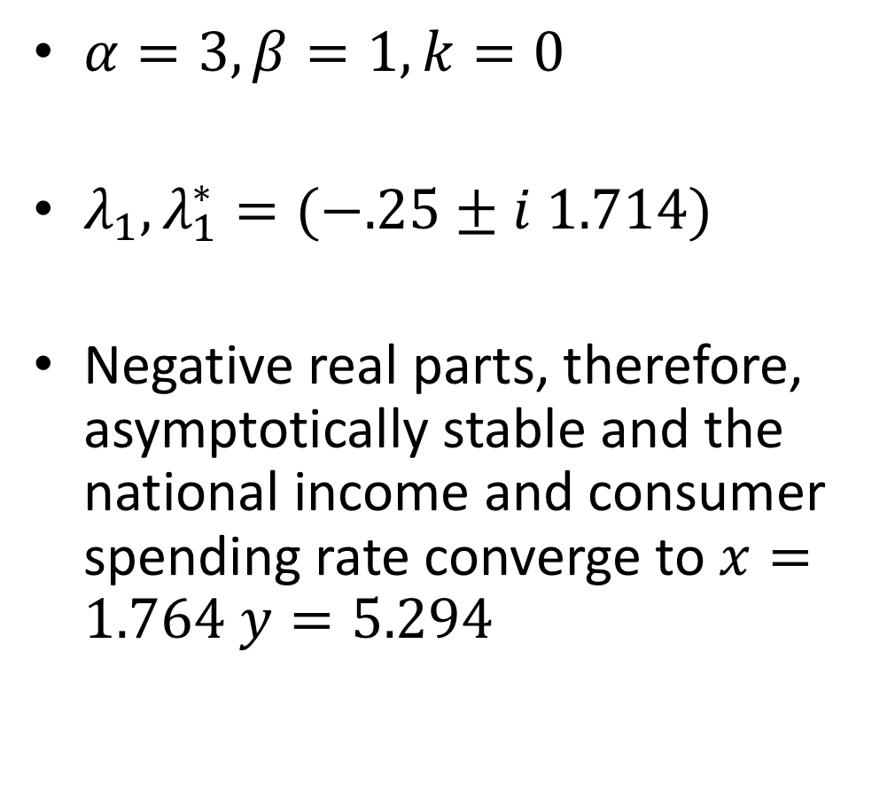
Example: Simple linear model of an economy
$α=3, β=1, k=0$
$λ_{1},λ_{1}^{∗}=(−.25±i 1.714)$
Negative real parts, therefore, asymptotically stable and the national income and consumer spending rate converge to $x=1.764$ $y=5.294$

Slide 36
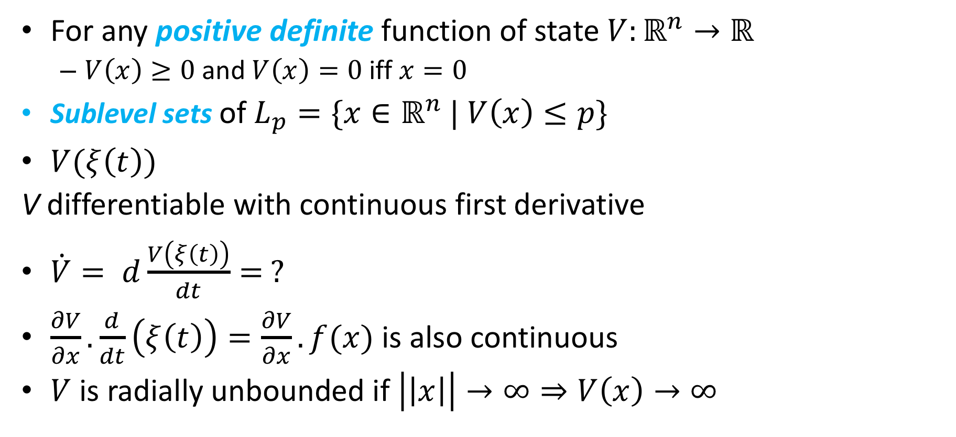
Stability of nonlinear systems
For any positive definite function of state $V:ℝ^{n}→ℝ$
$V\left(x\right)≥0$ and $V\left(x\right)=0$iff $x=0$
Sublevel sets of $L_{p}=\{x∈ℝ^{n}$ | $V\left(x\right)≤p\}$
$V(ξ\left(t\right))$
V differentiable with continuous first derivative
$\dot{V}= d\frac{V\left(ξ\left(t\right)\right)}{dt}= ?$
$\frac{∂V}{∂x}.\frac{d}{dt}\left(ξ\left(t\right)\right)=\frac{∂V}{∂x}.f(x)$ is also continuous
$V$ is radially unbounded if $\left|\left|x\right|\right|→∞⇒V\left(x\right)→∞$

Slide 37
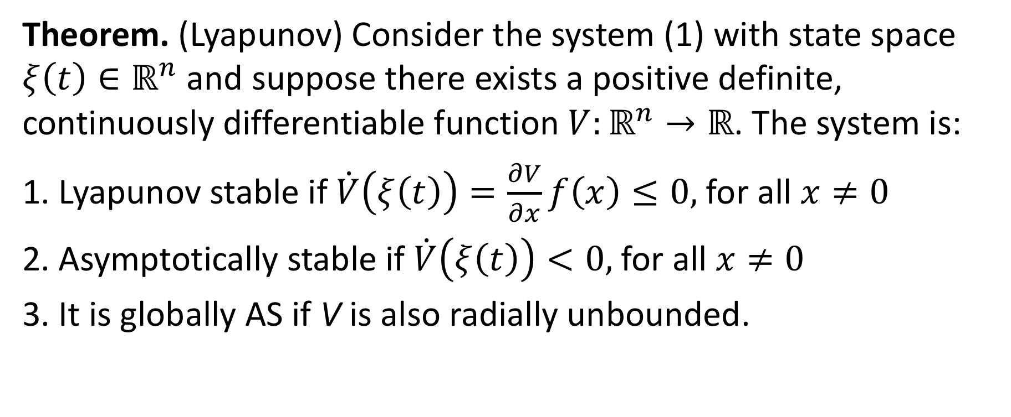
Verifying Stability
Theorem. (Lyapunov) Consider the system (1) with state space $ξ\left(t\right)∈ℝ^{n}$ and suppose there exists a positive definite, continuously differentiable function $V:ℝ^{n}→ℝ$. The system is:
1. Lyapunov stable if $\dot{V}\left(ξ\left(t\right)\right)=\frac{∂V}{∂x}f\left(x\right)≤0,$ for all $x≠0$
2. Asymptotically stable if $\dot{V}\left(ξ\left(t\right)\right)<0,$ for all $x≠0$
3. It is globally AS if V is also radially unbounded.

Slide 38

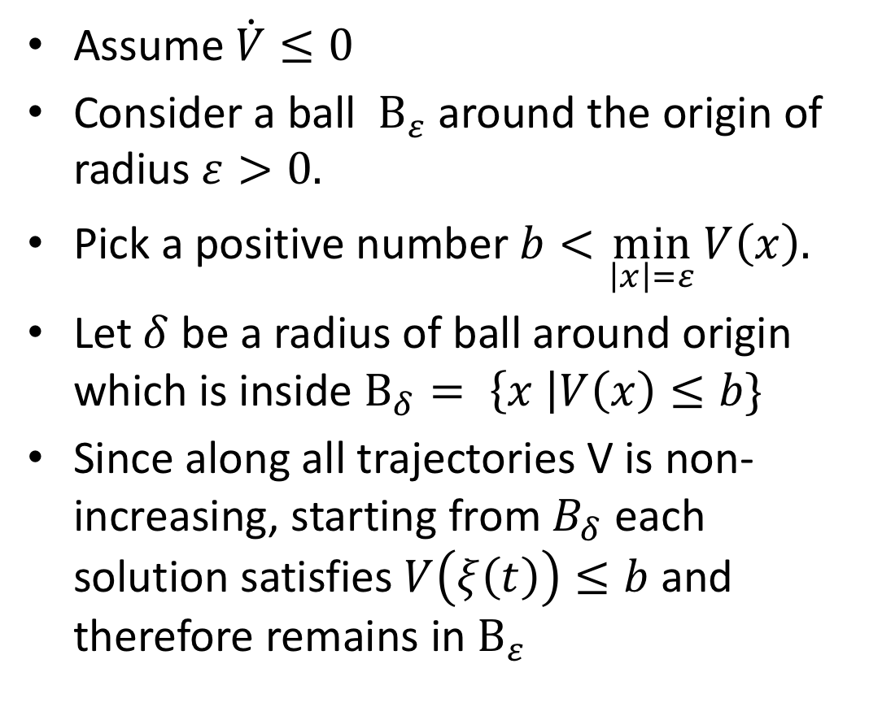

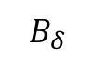
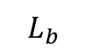
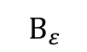
Proof sketch: Lyapunov stable if $\dot{V}≤0$
Assume $\dot{V}≤0$
Consider a ball $B_{ε}$around the origin of radius $ε>0.$
Pick a positive number $b<\min_{\left|x\right|=ε}{V\left(x\right).}$
Let $δ$ be a radius of ball around origin which is inside $B_{δ}= \left\{x \right|V\left(x\right)≤b\}$
Since along all trajectories V is non-increasing, starting from $B_{δ}$ each solution satisfies $V\left(ξ\left(t\right)\right)≤b$and therefore remains in $B_{ε}$
$$B_{ε}$$
$$L_{b}$$
$$B_{δ}$$

Slide 39
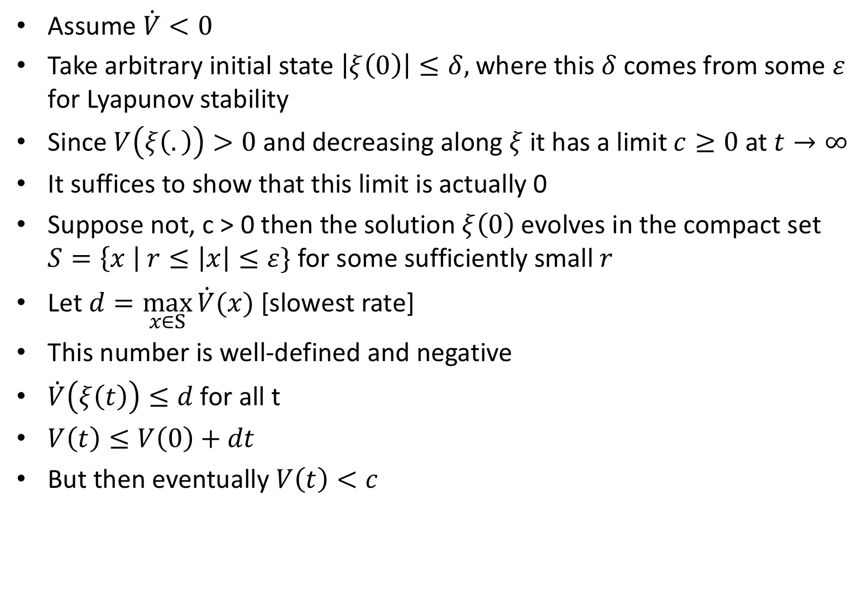
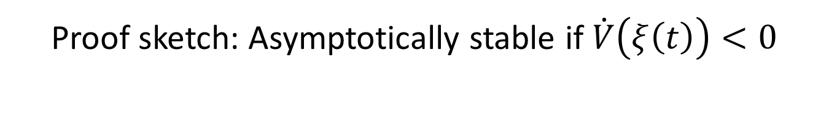
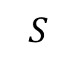
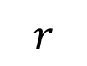
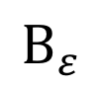
Proof sketch: Asymptotically stable if $\dot{V}\left(ξ\left(t\right)\right)<0$
Assume $\dot{V}<0$
Take arbitrary initial state $\left|ξ\left(0\right)\right|≤δ,$where this $δ$ comes from some $ε$ for Lyapunov stability
Since $V\left(ξ\left(.\right)\right)>0$ and decreasing along $ξ$it has a limit $c≥0$at $t→∞$
It suffices to show that this limit is actually 0
Suppose not, c > 0 then the solution $ξ\left(0\right)$evolves in the compact set $S=\left\{x \right| r≤\left|x\right|≤ε\}$ for some sufficiently small $r$
Let $d=\max_{x∈S}{\dot{V}(x)}$ [slowest rate]
This number is well-defined and negative
$\dot{V}\left(ξ\left(t\right)\right)≤d$for all t
$V\left(t\right)≤V\left(0\right)+dt$
But then eventually $V\left(t\right)<c$
$$B_{ε}$$
$$r$$
$$S$$

Slide 40




Example 2: Reasoning about stability without solving ODEs
$${\dot{x}}_{1}=−x_{1}+g(x_{2})$$
$${\dot{x}}_{1}=−x_{1}+g\left(x_{2}\right);{\dot{x}}_{2}=−x_{2}+h\left(x_{1}\right)$$
Given that $\left|g\left(x_{2}\right)\right|≤\frac{\left|x_{2}\right|}{2},\left|h\left(x_{1}\right)\right|≤\frac{\left|x_{1}\right|}{2}$
Use $V=\frac{1}{2}\left(x_{1}^{2}+x_{2}^{2}\right)≥0$
$\dot{V}=x_{1} {\dot{x}}_{1}+x_{2} {\dot{x}}_{2}$
=${−x}_{1}^{2}{−x}_{2}^{2}+x_{1}g\left(x_{2}\right)+x_{2}h\left(x_{1}\right)$
$≤{−x}_{1}^{2}{−x}_{2}^{2}+\frac{1}{2}\left({|x}_{1}x_{2}|+|x_{2}x_{1}|\right)$
$≤−{\frac{1}{2}(x}_{1}^{2}+x_{2}^{2})=−V$
We conclude global asymptotic stability (in fact global exponential stability) without knowing solutions
$${\dot{x}}_{2}=−x_{2}+h(x_{1})$$
$${\left(\left|x_{1}\right|−\left|x_{2}\right|\right)}^{2}≥0$$
$$x_{1}^{2}+x_{2}^{2}≥2\left|x_{1}x_{2}\right|$$
$$\left|x_{1}x_{2}\right|≤\frac{1}{2}(x_{1}^{2}+x_{2}^{2})$$

Slide 41

Proposition. If V is a Lyapunov function then every sublevel set of V is an invariant
Proof. $V\left(ξ\left(t\right)\right)=$
$=V\left(ξ\left(0\right)\right)+\int_{0}^{t}{\dot{V}\left(ξ\left(τ\right)\right)dτ}$
$≤V(ξ(0))$

Slide 42

An aside: Checking inductive invariants
$A=\left\langle X,Q_{0},T\right\rangle$
$X:$ set of variables
$Q_{0}⊆val\left(X\right)$
$T⊆val\left(X\right)×val\left(X\right)$ written as a program $x′⊆T(x)$
How do we check that $I⊆val(X)$ is an inductive invariant?
$Q_{0}⇒I(X)$
$I\left(X\right)⇒I(T\left(X\right))$
Implies that $Reach_{A}\left(Q_{0}\right)⊆I$without computing the executions or reachable states of A
The key is to find such $I$

Slide 43
Finding Lyapunov Functions
The key to using Lyapunov theory is to find a Lyapunov function and verify that it has the properties
In general, for nonlinear systems this is hard
There are several approaches
Quadratic Lyapunov functions for linear systems
Decide the form/template of the function (e.g., quadratic, polynomial), parameterized by some parameters and find values of the parameters so that the conditions hold (Chapter 3 last section)

Slide 44

Linear autonomous systems
$\dot{x}=Ax, A∈ℝ^{n×n}$
The Lyapunov equation: $A^{T}P+PA+Q=0$
where $P,Q∈ℝ^{n×n}$ are symmetric
Interpretation: $V\left(x\right)=x^{T}Px$ then
$\dot{V}\left(x\right)={\left(Ax\right)}^{T}Px+x^{T}P(Ax)$
[using chain rule $\frac{∂u^{T}Pv}{∂t}=\frac{∂u}{∂t}Pv+\frac{∂v}{∂t}P^{T}u]$
=${ x}^{T}\left(A^{T}P+PA\right)x=−x^{T}Qx$
If $x^{T}Px$ is the generalized energy then $−x^{T}Qx$ is the associated dissipation

Slide 45

Quadratic Lyapunov Functions
If $P>0$ (positive definite)
$V\left(x\right)=x^{T}Px=0⇔x=0$
The sub-level sets are ellipsoids
If $Q>0$ then the system is globally asymptotically stable

Slide 46


Same example
Lyapunov equations are solved as a set of $\frac{n\left(n+1\right)}{2}$ equations in $n\left(n+1\right)/2$ variables. Cost O($n^{6})$
Choose $Q=\left[\begin{matrix}1 & 0 \\ 0 & 1\end{matrix}\right]$ solving Lyapunov equations we get $P= \left[\begin{matrix}2.59 & −2.29 \\ −2.29 & 4.92\end{matrix}\right]$ and we get the quadratic Lyapunov function $\left(x−x^{∗}\right)P{\left(x−x^{∗}\right)}^{T}$ an a sequence of invariants

Slide 47

Converse Lyapunov
Converse Lyapunov theorems show that conditions of the previous theorem are also necessary. For example, if the system is asymptotically stable then there exists a positive definite, continuously differentiable function V, that satisfies the inequalities.
For example if the LTI system $\dot{x}=Ax$ is globally asymptotically stable then there is a quadratic Lyapunov function that proves it.

Slide 48
Small puzzle
Platonic solids. Solid bodies whose faces are regular polygons, all identical, that meet in identical fashion at every vertex. How many such are there? Exactly five!
Platonic solids.
Wilczek, Frank. A Beautiful Question: Finding Nature's Deep Design (p. 39).

